Slide 1

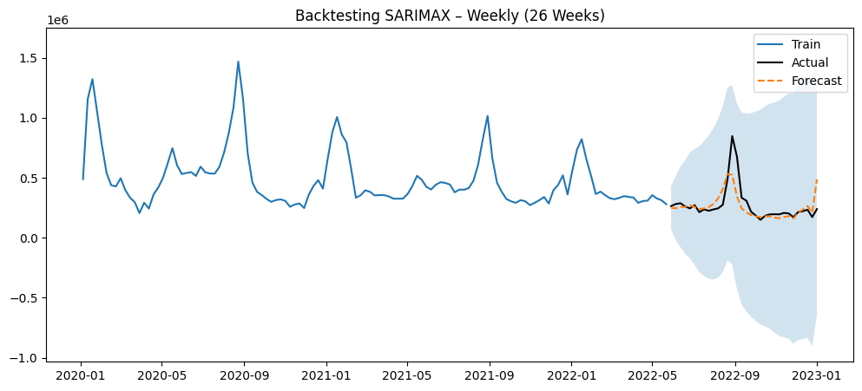
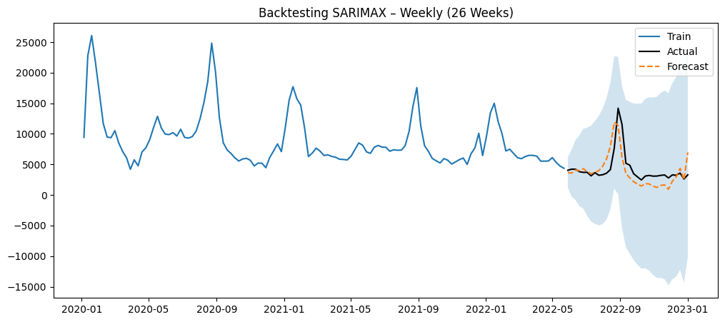
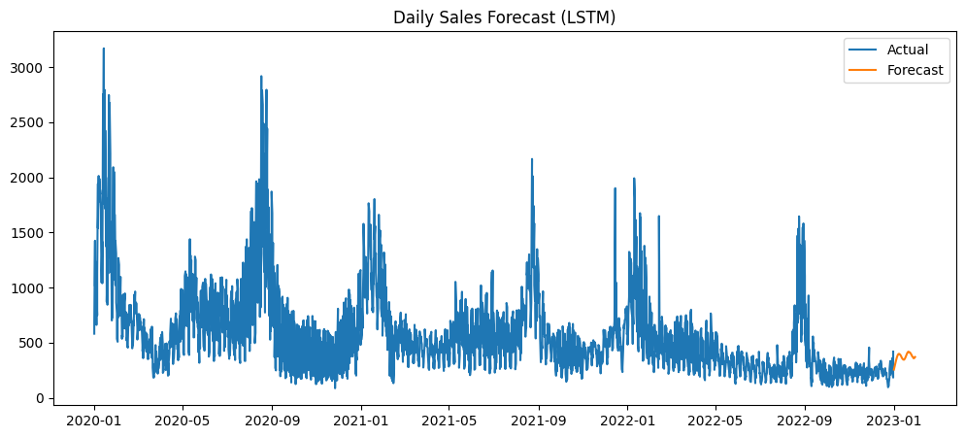
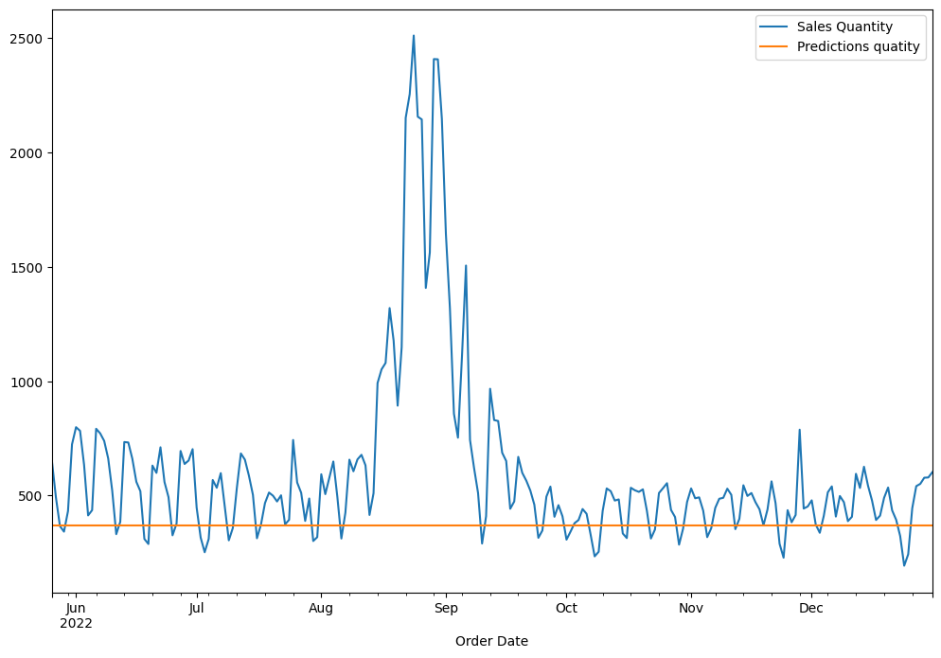
Model Result - Chart
SARIMAX
Amount
Quantity
LSTM
LSTM QTY-Short Period(30 Days)
Long Period – 3 years

Slide 2
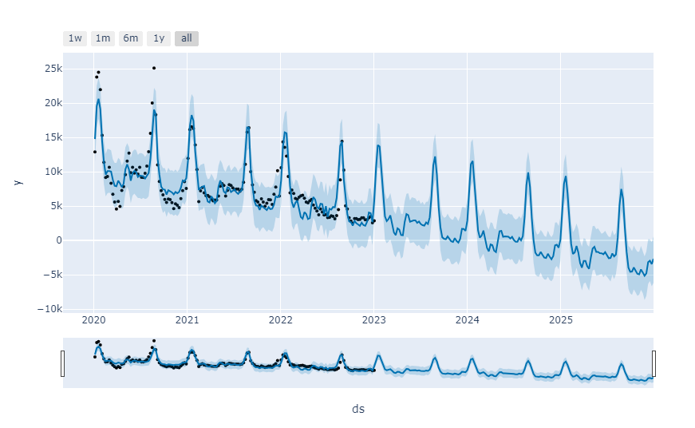
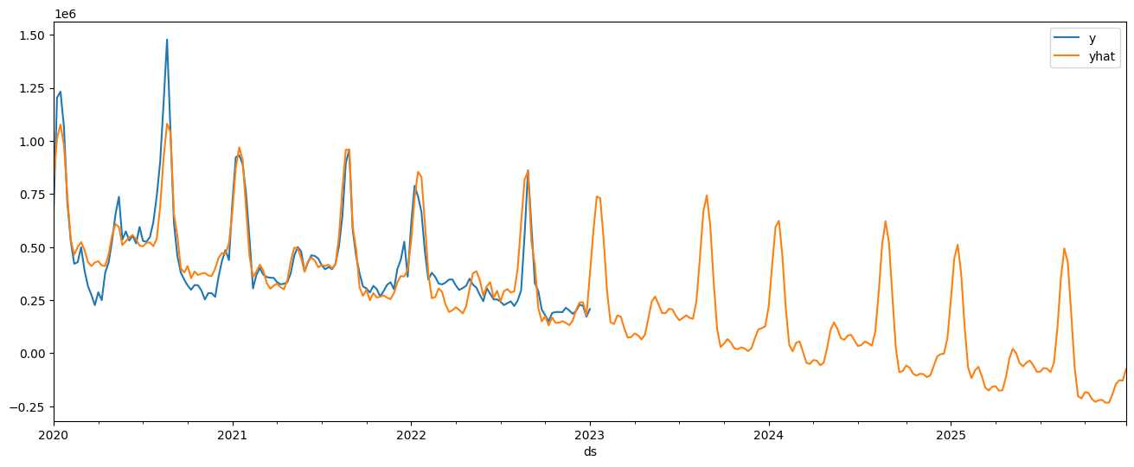
SARIMAX
Amount
Quantity
Conclusion
SARIMAX is the most suitable model for 3-year forecasting due to its lowest MAPE, strong ability to capture both long-term trends and seasonality, and its stability over long forecasting horizons.
In contrast, LSTM and Random Forest are more appropriate for short- to medium-term forecasting. They are not suitable for a 3-year horizon because their prediction patterns tend to be unstable and unrealistic, they struggle to consistently capture long-term trends, and their forecasts become increasingly volatile as the horizon extends.
MAPE is used as the primary evaluation metric because it measures relative error in percentage terms, making it easier to compare model performance across different sales scales and ensuring interpretability for business stakeholders.
Why is Sarimax?
SARIMAX explicitly models autoregressive (AR), moving average (MA), and seasonal components, allowing it to follow long-term trends and recurring seasonal patterns (such as annual or weekly seasonality) in a stable and interpretable manner.
Prophet applies additive or multiplicative decompositions for trend and seasonality. However, it may struggle to accurately capture complex long-term fluctuations, especially when the data exhibits irregular or non-consistent seasonal patterns, resulting in less reliable long-horizon forecasts compared to SARIMAX.

Slide 3
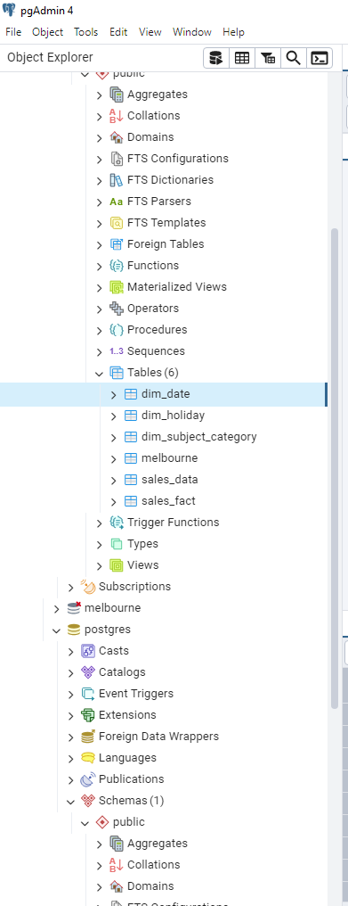
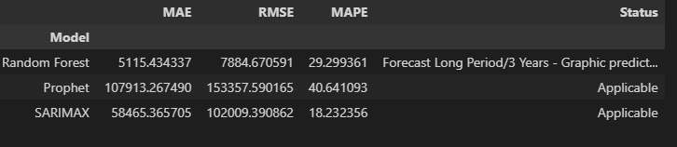
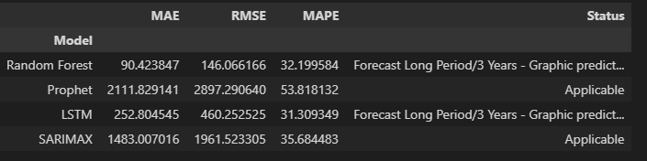
ETL - PostgreeSQL
Model Comparison
Quantity
Amount

